Slide 1
RecyclerView
STW300CEM Android Applications Development

Slide 2
What is RecyclerView ?
View Group to display large set of data.
For each item in large dataset, it display a view.
Efficient way to implement Scrollable list.

Slide 3
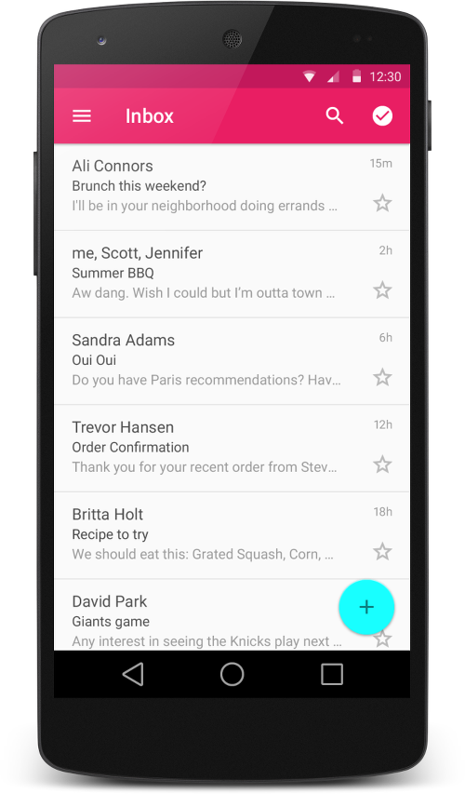
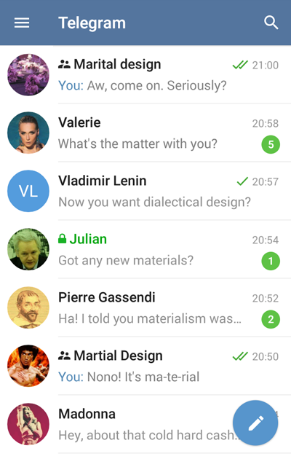
What is RecyclerView ?

Slide 4
What is RecyclerView?
DATA = [“item1”,”item2”,.....”item1000”]
For each item, we have a view. But if we create a view for each item in ONE GO then we have 1000 views but user can only see 10-15 (depends) views at a time. Memory wastage.

Slide 5
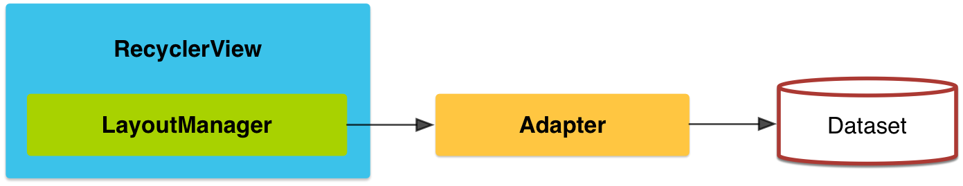
RecyclerView Concept
View Holder :
This will hold the view and helps in recycling.
Adapter :
This will adapt our data so that it can be displayed in a list.

Slide 6
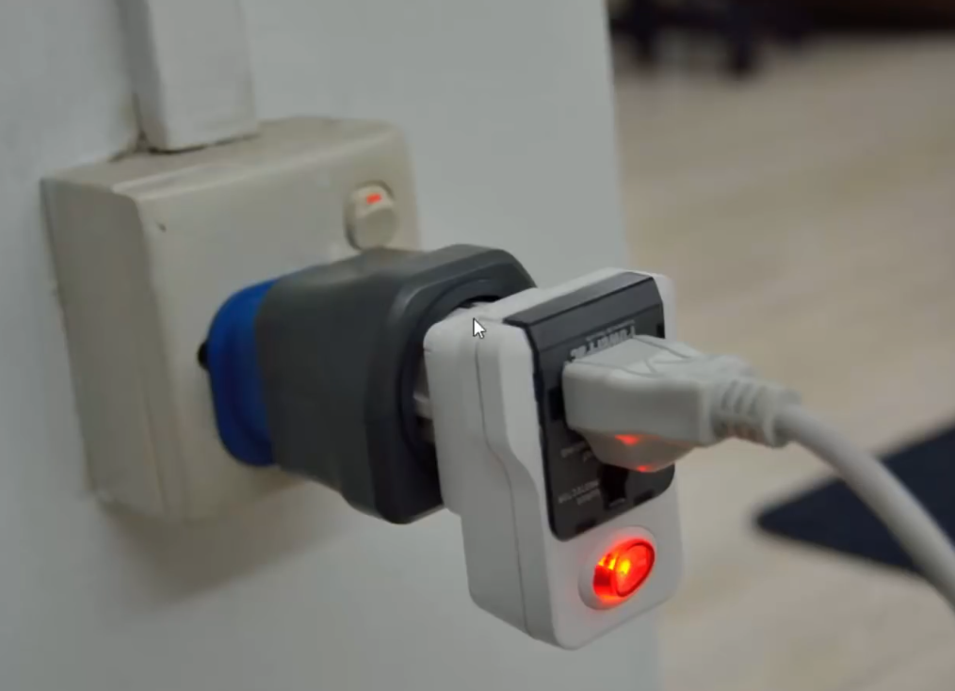

Slide 7
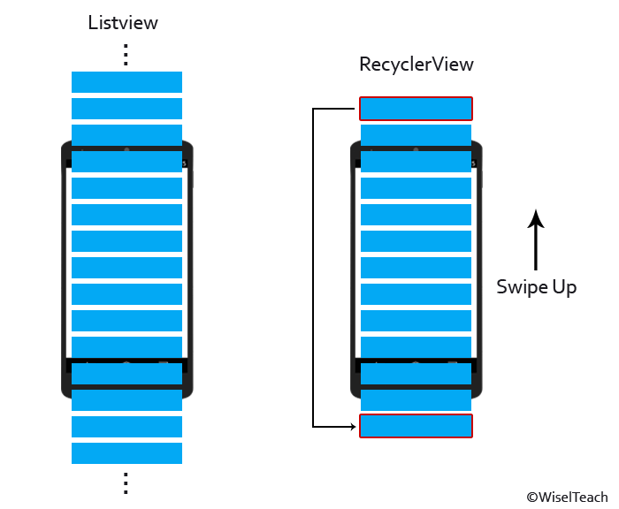
Working of RecyclerView

Slide 8
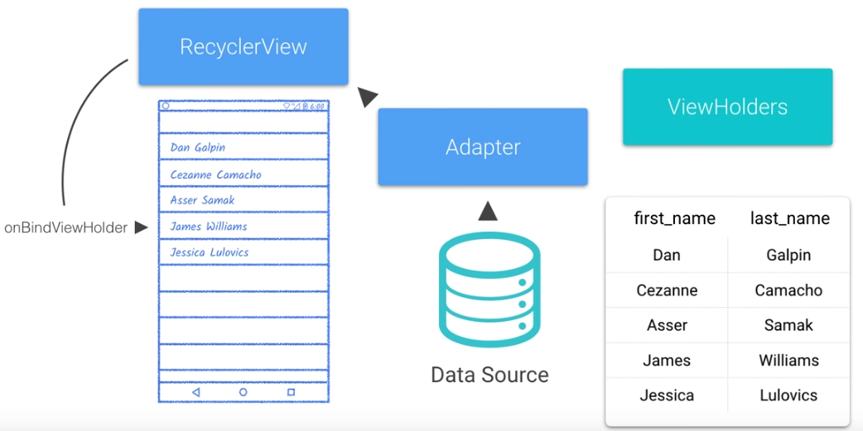
Working of RecyclerView

Slide 9
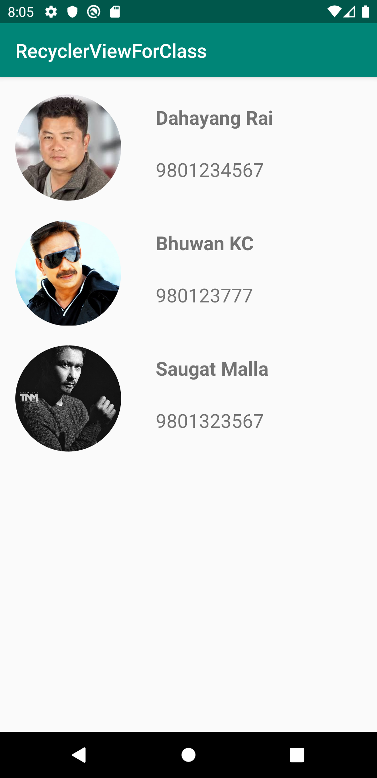
RecyclerView App

Slide 10
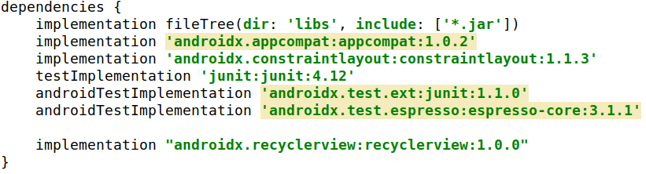
1. Add library for recyclerview in build.gradle
Copy and paste in build.gradle file
implementation "androidx.recyclerview:recyclerview:1.0.0"

Slide 11
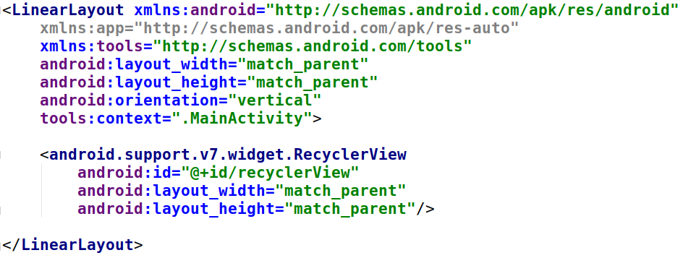
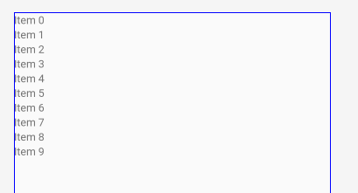
2. Add RecyclerView in XML

Slide 12
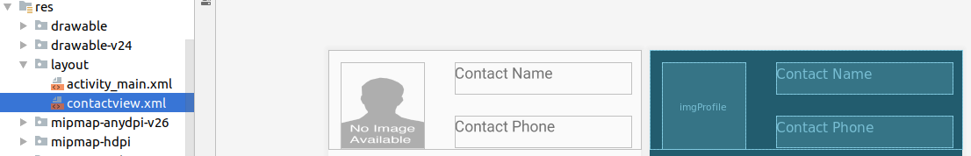
3. Add another layout file
go to res->layout-> right click and click new and create a layout resource file.
For now give a name as contact using constraint layout ( or any other layout)

Slide 13
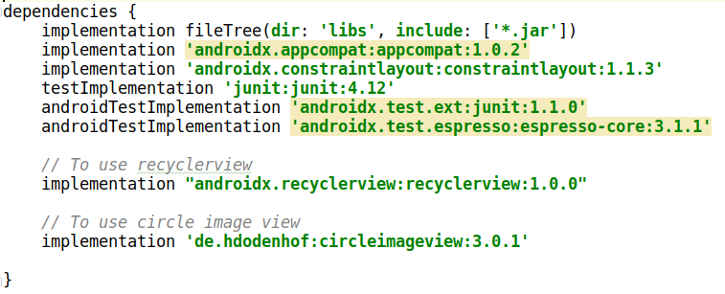
3. Using circular image view
implementation 'de.hdodenhof:circleimageview:3.0.1'

Slide 14
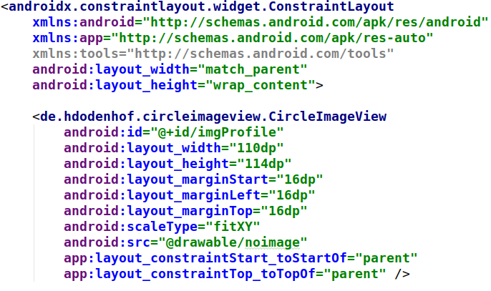
3. Using circular image view

Slide 15
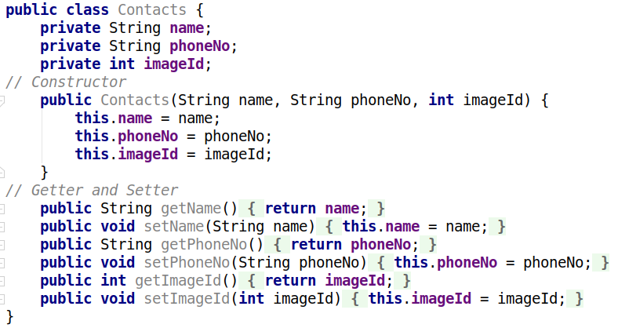
4. Create a model class
create a class named Contacts.java.

Slide 16
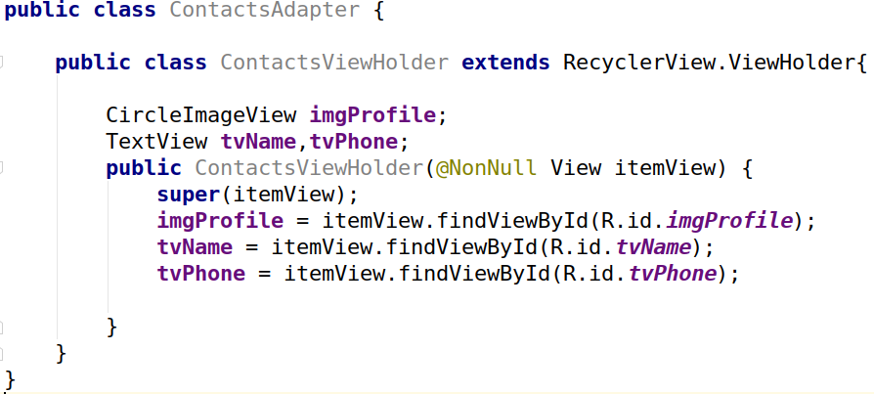
5. Create an Adapter for Contact class and add ViewHolder class
Inner Class

Slide 17
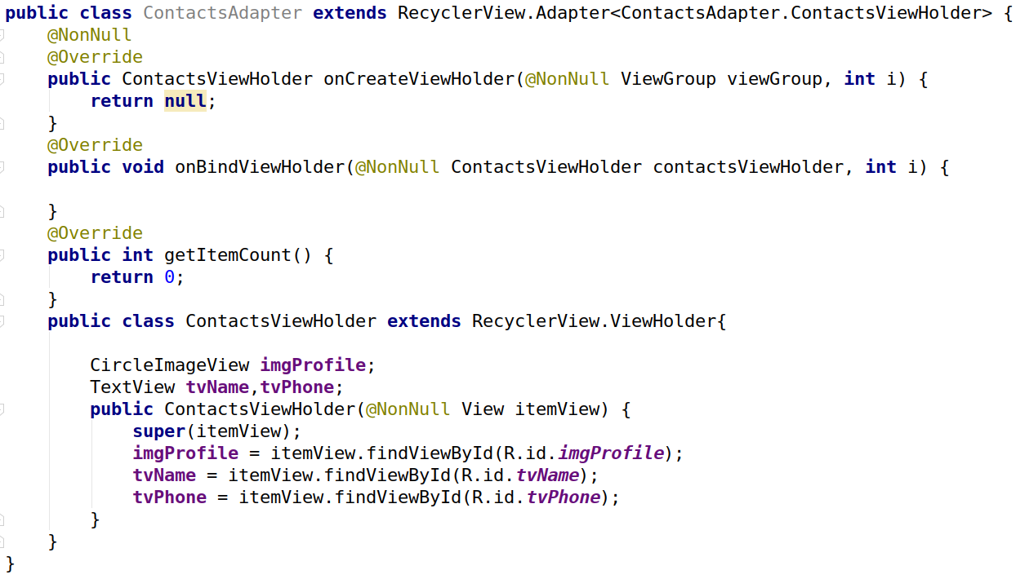
6. Extend the ViewHolder class in Adapter class

Slide 18
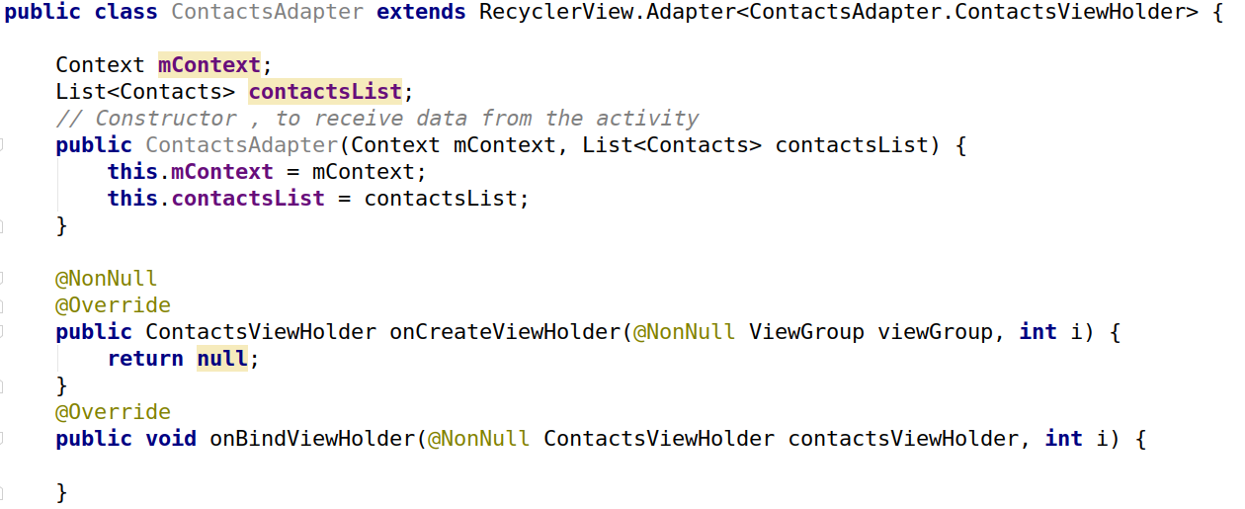
7. Create a constructor of adapter class

Slide 19
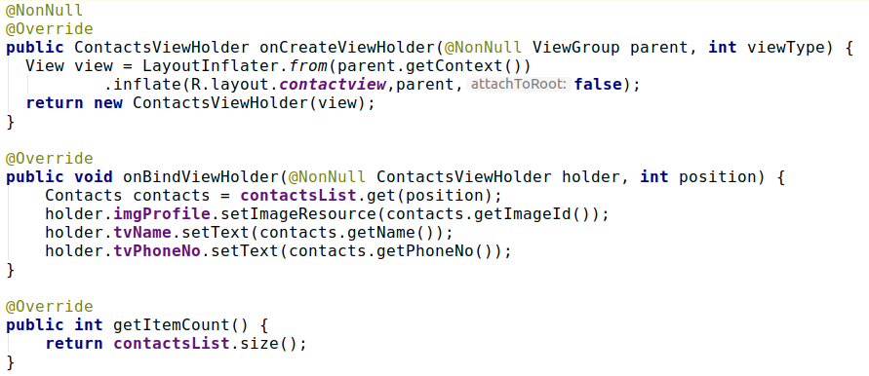
8. Override 3 methods of ViewHolder

Slide 20
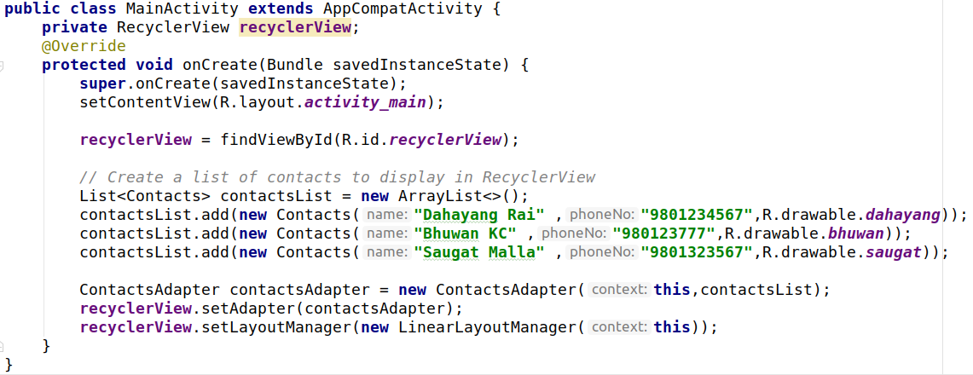
9. MainActivity

Slide 21
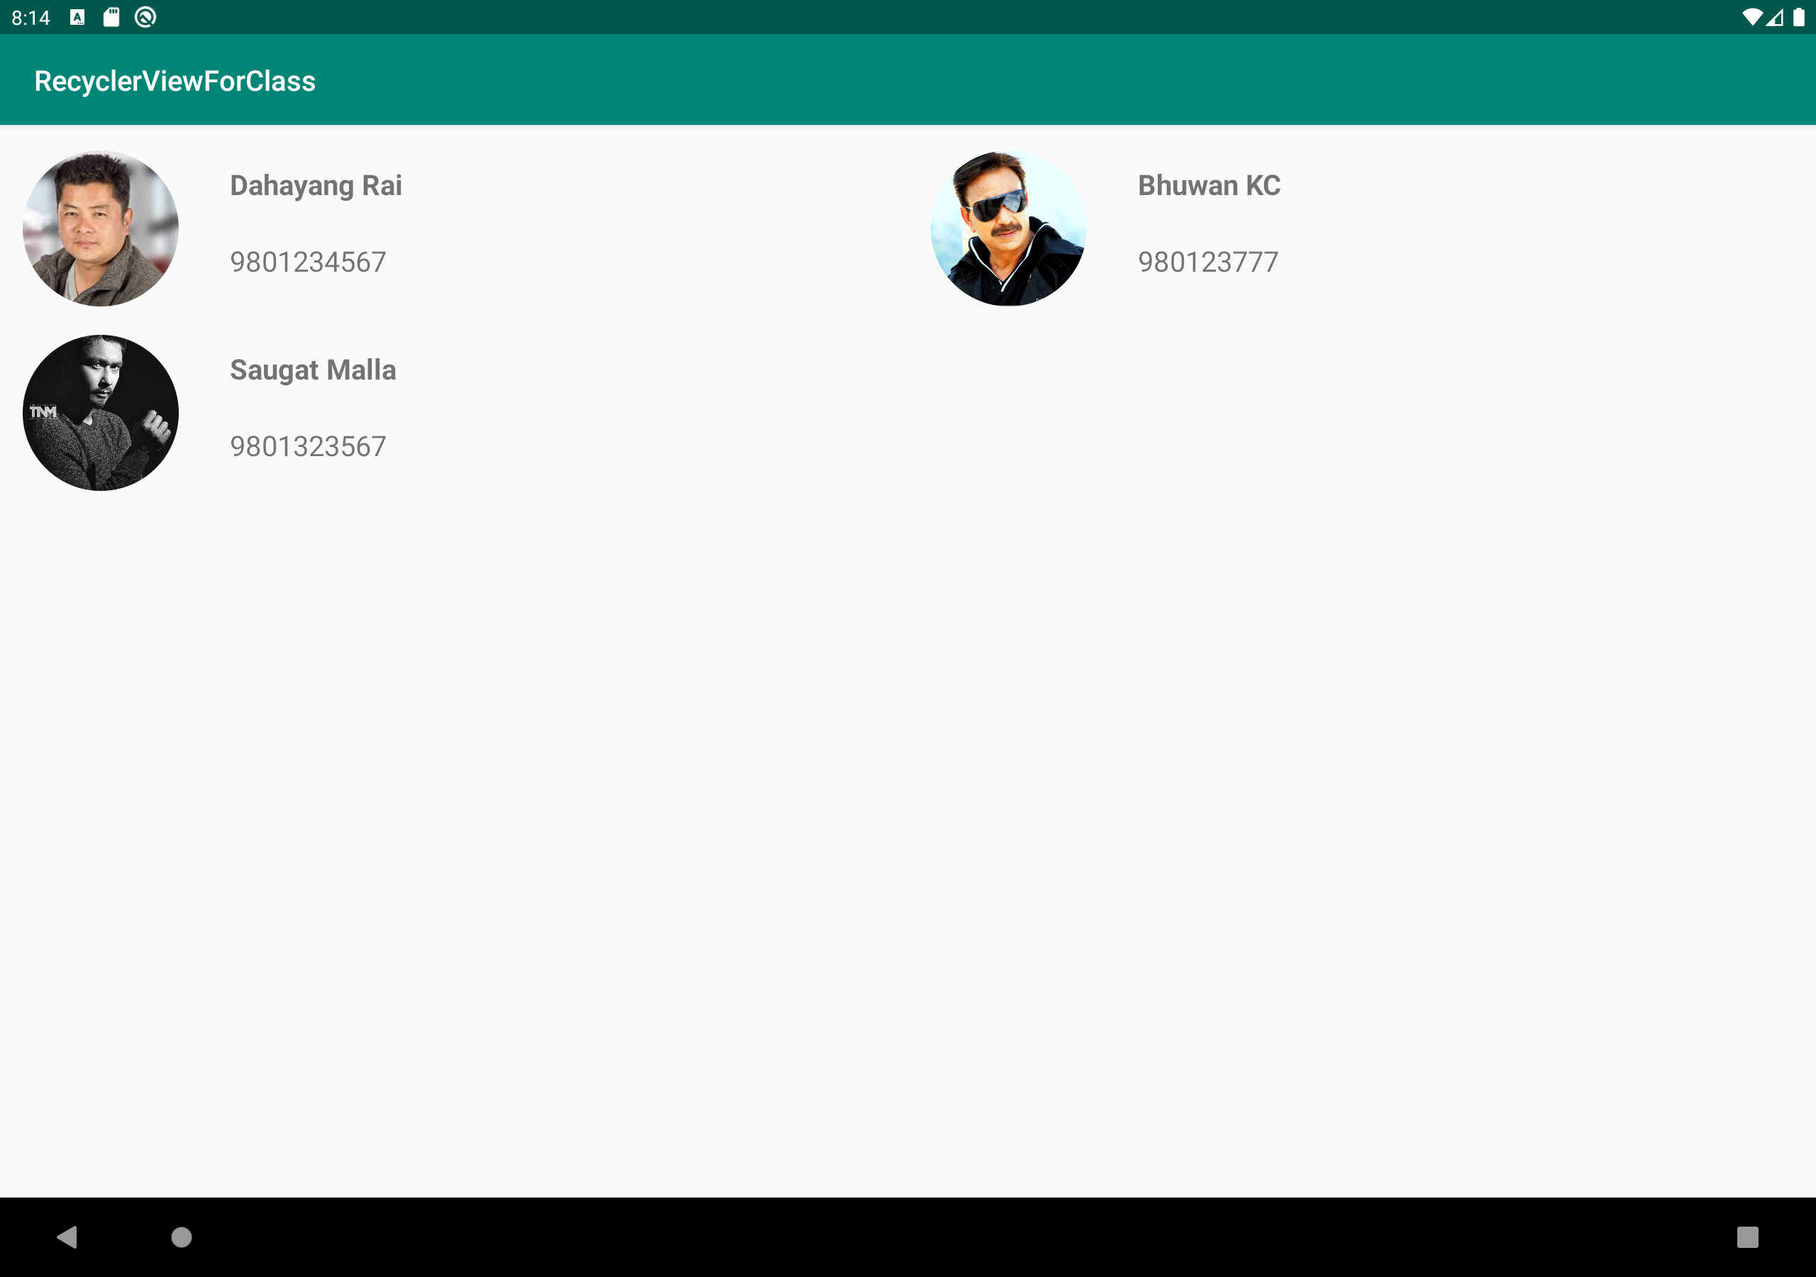
Displaying Contacts in gridLayout
Reduce the margin
and
textsize of Textview

Slide 22
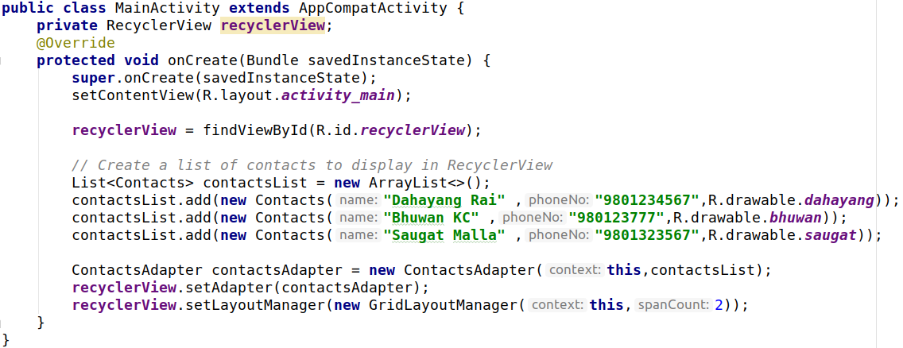
Code

Slide 23
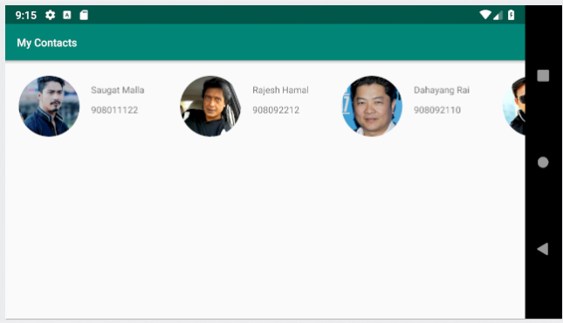
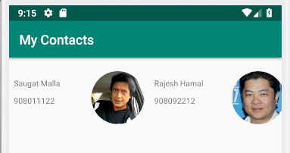
Displaying contacts horizontally

Slide 24
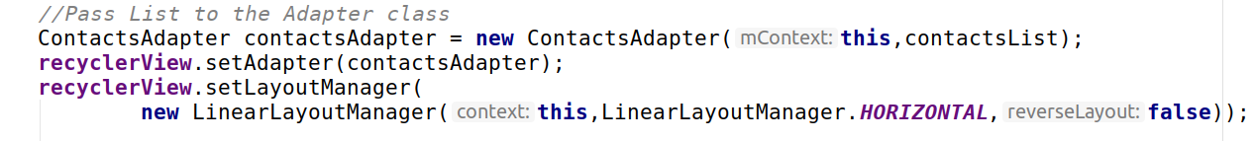
Code
Make Sure you set layout_width:wrap_content in relative layout

Slide 25
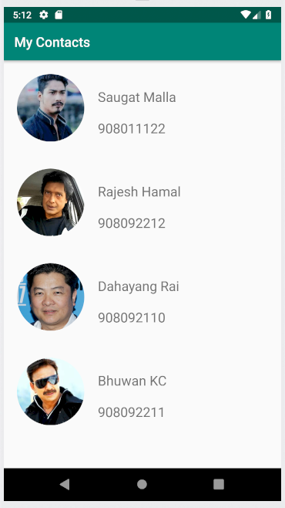
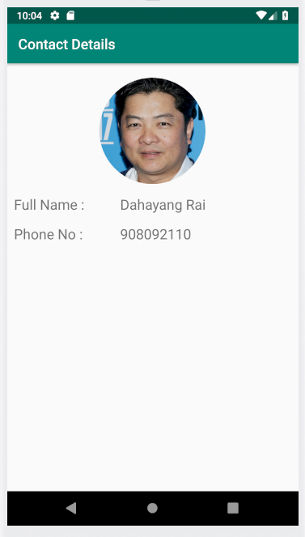
Displaying Contact details in another activity

Slide 26
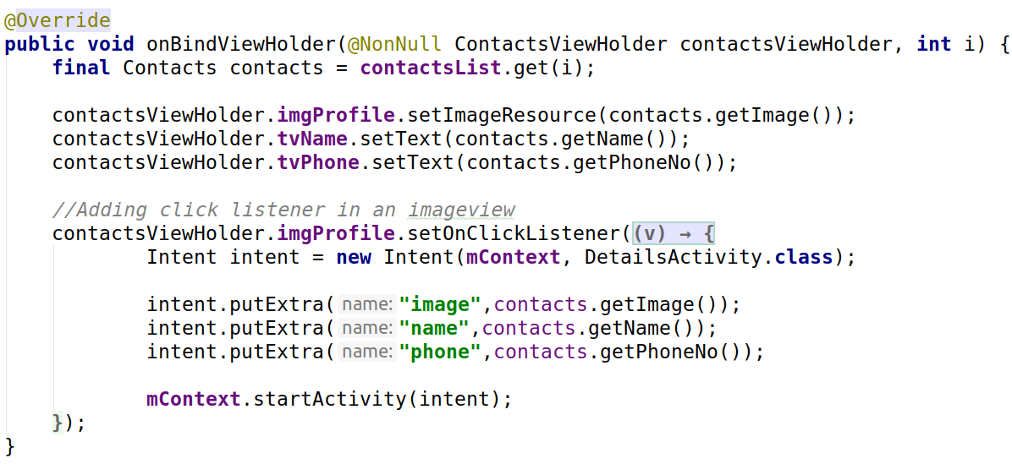
Adding click listener on ImageView in RecyclerView

Slide 27
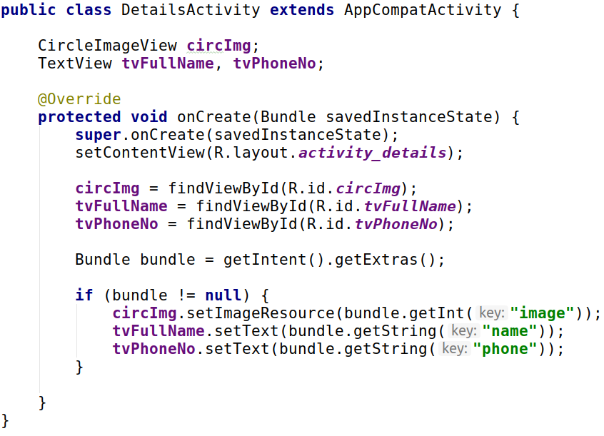
Another Activity

